Slide 1
Foundation 2025
Parent Information Session
Footscray City Primary School Date: Monday 25th March 2024

Slide 2
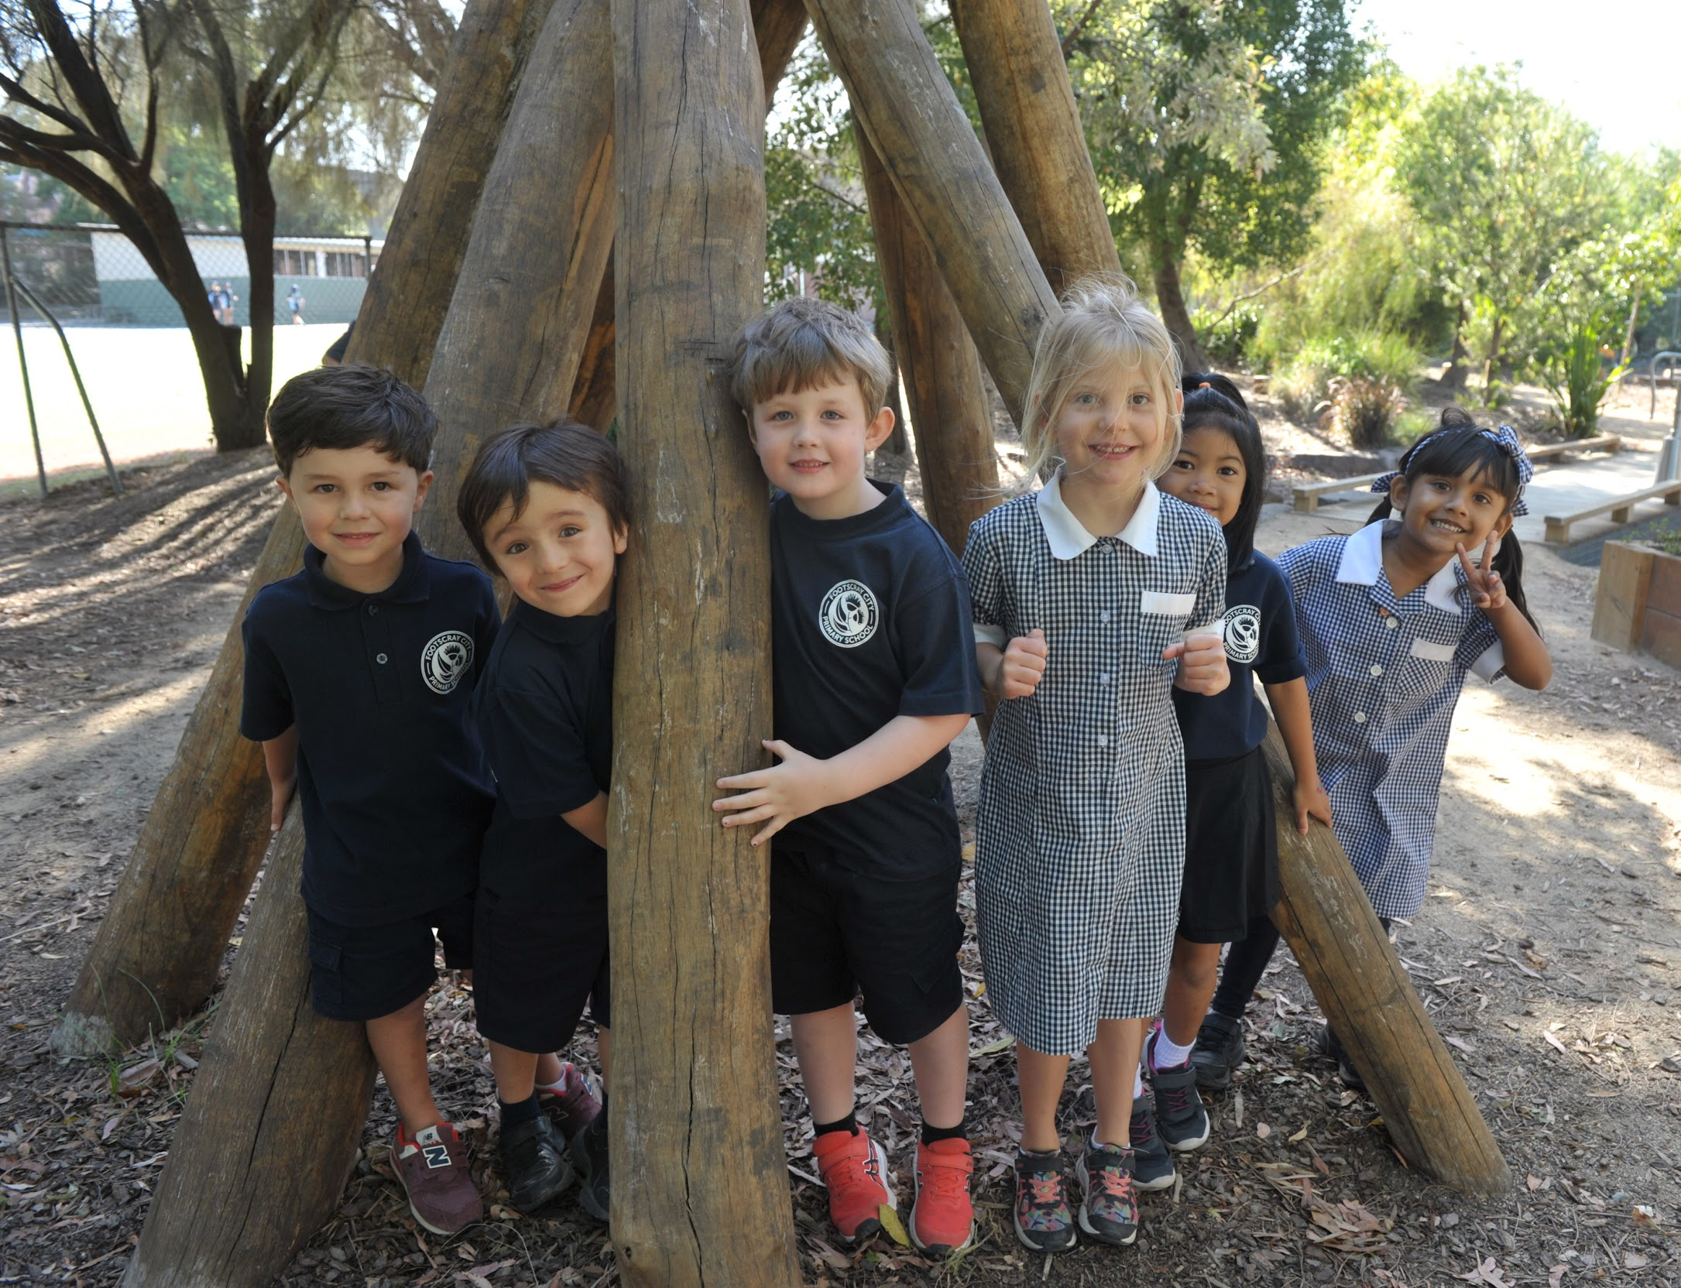
Clarity of Purpose
This session is designed to
Introduce you to key people and practices at Footscray City Primary School.
Communicate our key messages around how we approach:
Student learning, engagement and wellbeing
Provide an overview of school operations
Provide clarity on the next steps in the enrolment process
By attending it is our intention that you will have
knowledge of the learning programs your child will participate in
understanding of how we approach learning and teaching
connections with what you want and need for your child to learn and thrive

Slide 3
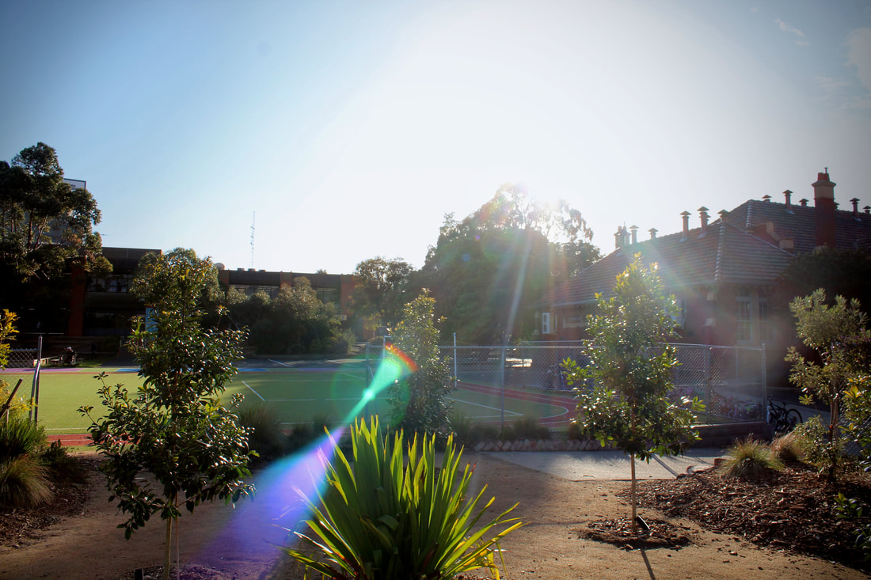
Acknowledgement of Country
We acknowledge the Wurundjeri Woi Wurrung and Bunurong peoples of the Kulin Nation, as the owners of this land we are standing and learning on. We will take very good care of the land, like how the Wurundjeri Woi Wurrung and Bunurong peoples took care of Australia.
We will contribute and strive to learn, like how the owners of this land always have, and still thrive and learn.

Slide 4
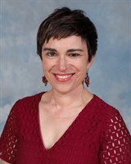
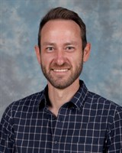
Our Leadership Team- Principal Class
Principal
Jessie Hand
Assistant Principal
Year 3-6
Anthony Curnow
Assistant Principal
Foundation - Year 2
Eliza Kerin
Assistant Principal
Disability & Inclusion Leader
Grace Speight

Slide 5
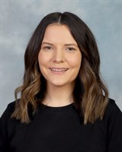
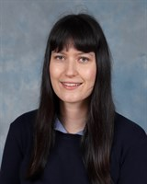
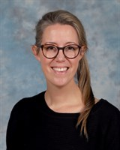
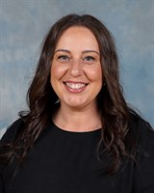
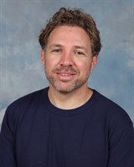
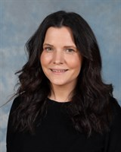
Supporting Leadership Team
Learning Specialist
Georgia Hynes
Learning Specialist
Helen Dearn
Learning Specialist
Sandra Tiricola
Acting Learning Specialist
James Jardine
STEAM Specialist
Learning Specialist
Juliet Thompson
(Returning Term 2)

Slide 6
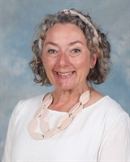
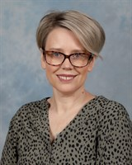
Wellbeing Team
Supporting Principal Class
Mental Health & Wellbeing Leader
Jenine O’Brien
Student Engagement & Wellbeing Coordinator
Emma Boyd
(Returning Term 2)

Slide 7
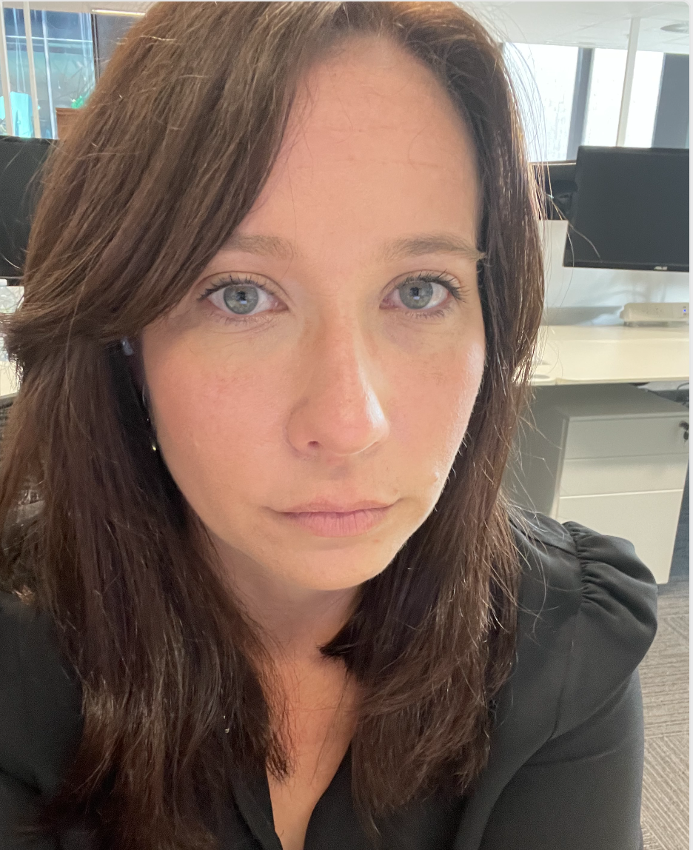
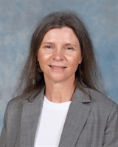
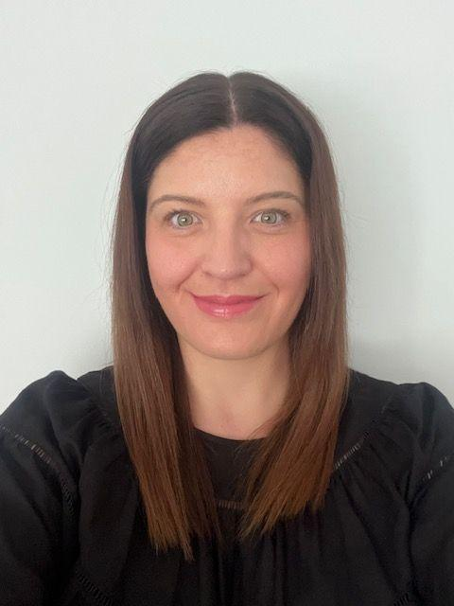
Our Administration Team
Business Manager
Juli Walker
Office Manager
Sue Southern
Administration Manager
Michelle Cox
Mon-Wed
Administration Manager
Elizabeth Millar
Wed-Fri

Slide 8
Our Mission at FCPS
We are future making for every child so that they are learning to learn, learning to thrive and learning to contribute.
Our Vision at FCPS
Our students will possess the skills, knowledge and ways of thinking that enable them to embrace learning, respond to challenges and thrive as active members of the community.
Our Values at FCPS
At Footscray City Primary School we are a diverse and inclusive COMMUNITY who value
Taking RESPONSIBILITY for our learning and our impact on our selves, others and our environment.
Thinking and acting with KINDNESS which means we are friendly towards others and considerate of their feelings.
Demonstrating RESILIENCE by persisting and being courageous when faced with challenges in our learning and relationships.

Slide 9
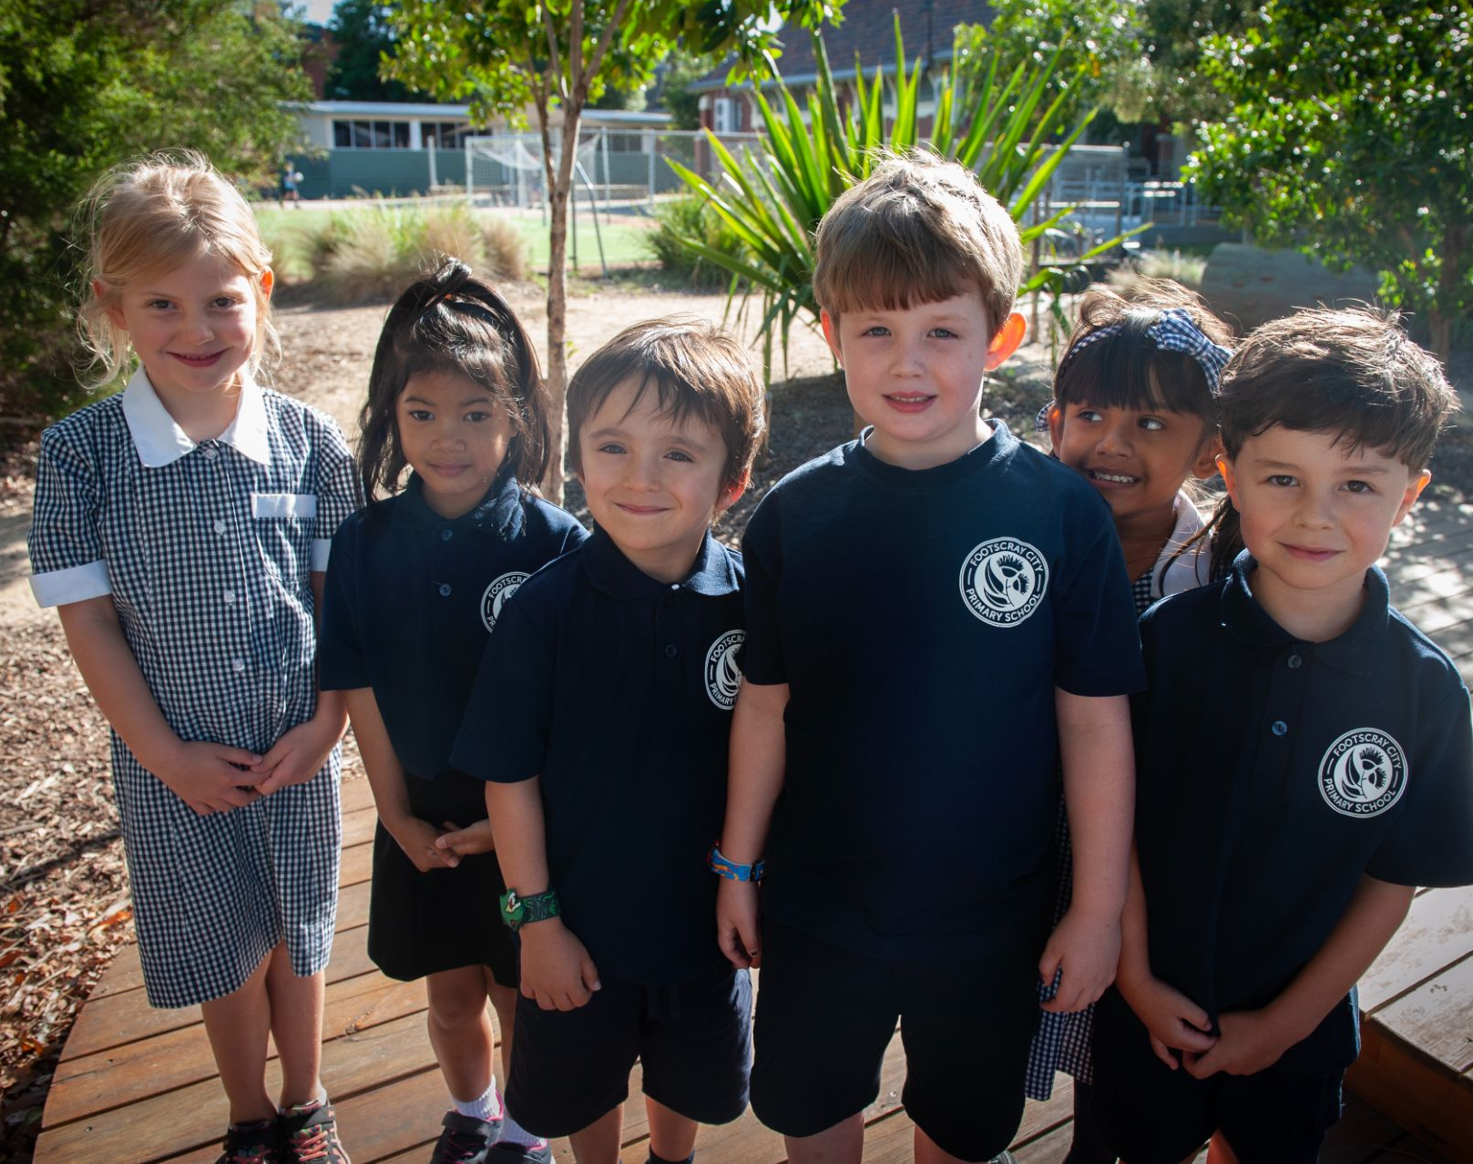
Professional Learning Community
At FCPS we are driven by the big ideas of a
Professional Learning Community (PLC):
A focus on all students learning at high levels
A focus on wellbeing
A focus on collaboration
A focus on results

Slide 10
Curriculum Overview
Victorian Curriculum
English
Reading, Writing, Spelling & Punctuation, Speaking & Listening
Mathematics
Number & Algebra, Measurement & Geometry, Statistics & Probability
Concept Learning
Science, Humanities, Technologies, Personal & Social Capabilities, Critical & Creative Thinking
Wellbeing
School Wide Positive Behaviour Support (SWPBS), Resilience, Rights & Respectful Relationships,Personal & Social Capabilities

Slide 11
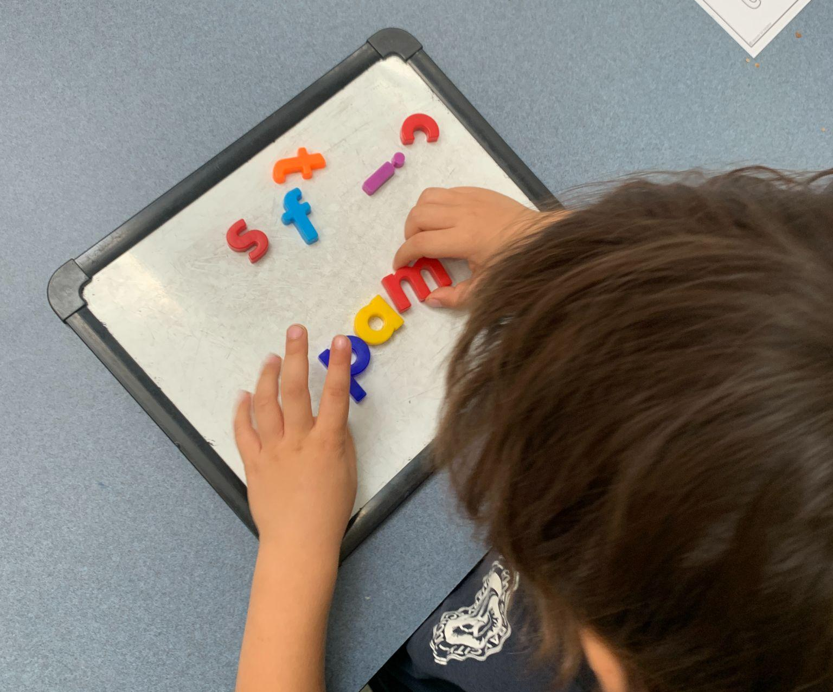
Literacy
Little Learners Love Literacy
In Foundation, we are teaching literacy using Little Learners Love Literacy. This is a structured and sequential program focused on explicit teaching of:
phonemic awareness and phonics for reading and spelling
handwriting
vocabulary and oral language skills
Decodable Books
Rich mentor texts

Slide 12
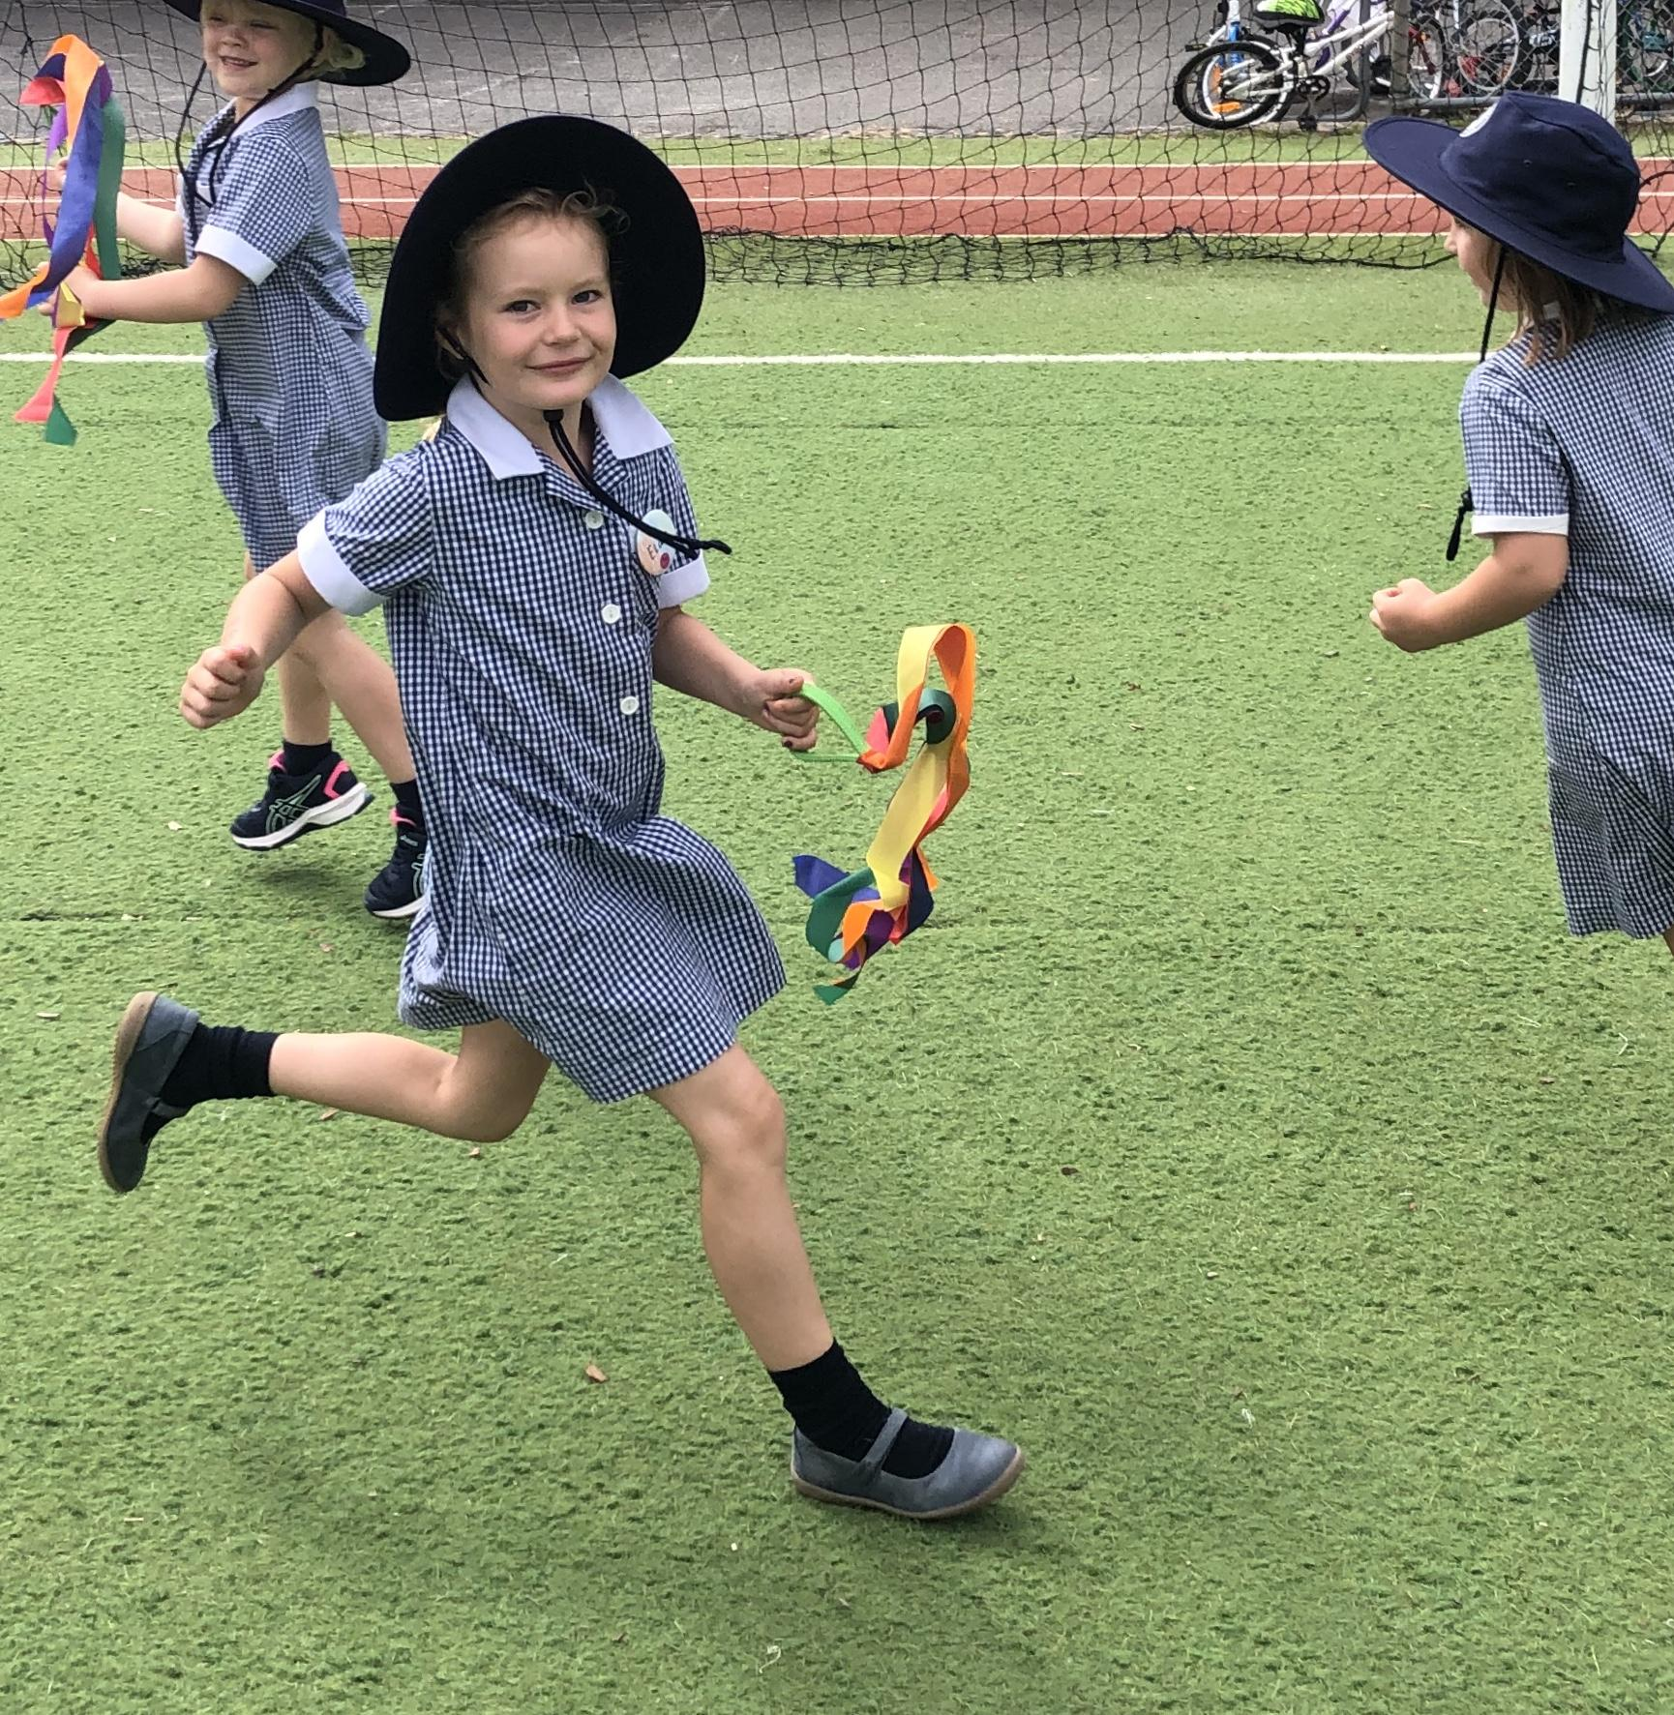
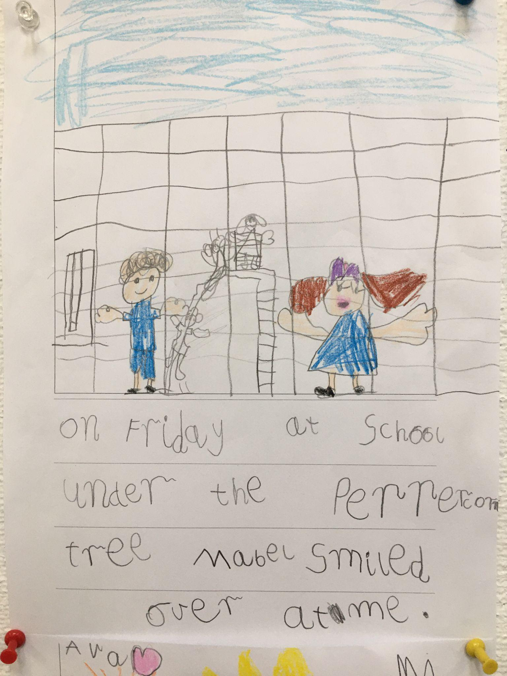
Writing
Language Experience & Mentor Texts Shared vocabulary Modelled Writing Shared Writing Guided Writing Plan by drawing - planting ‘seeds’ (ideas) on paper Verbalising/sharing thinking before writing (Think it, Say it, Write it) Recording sounds in words

Slide 13
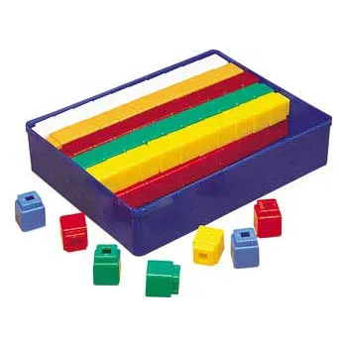
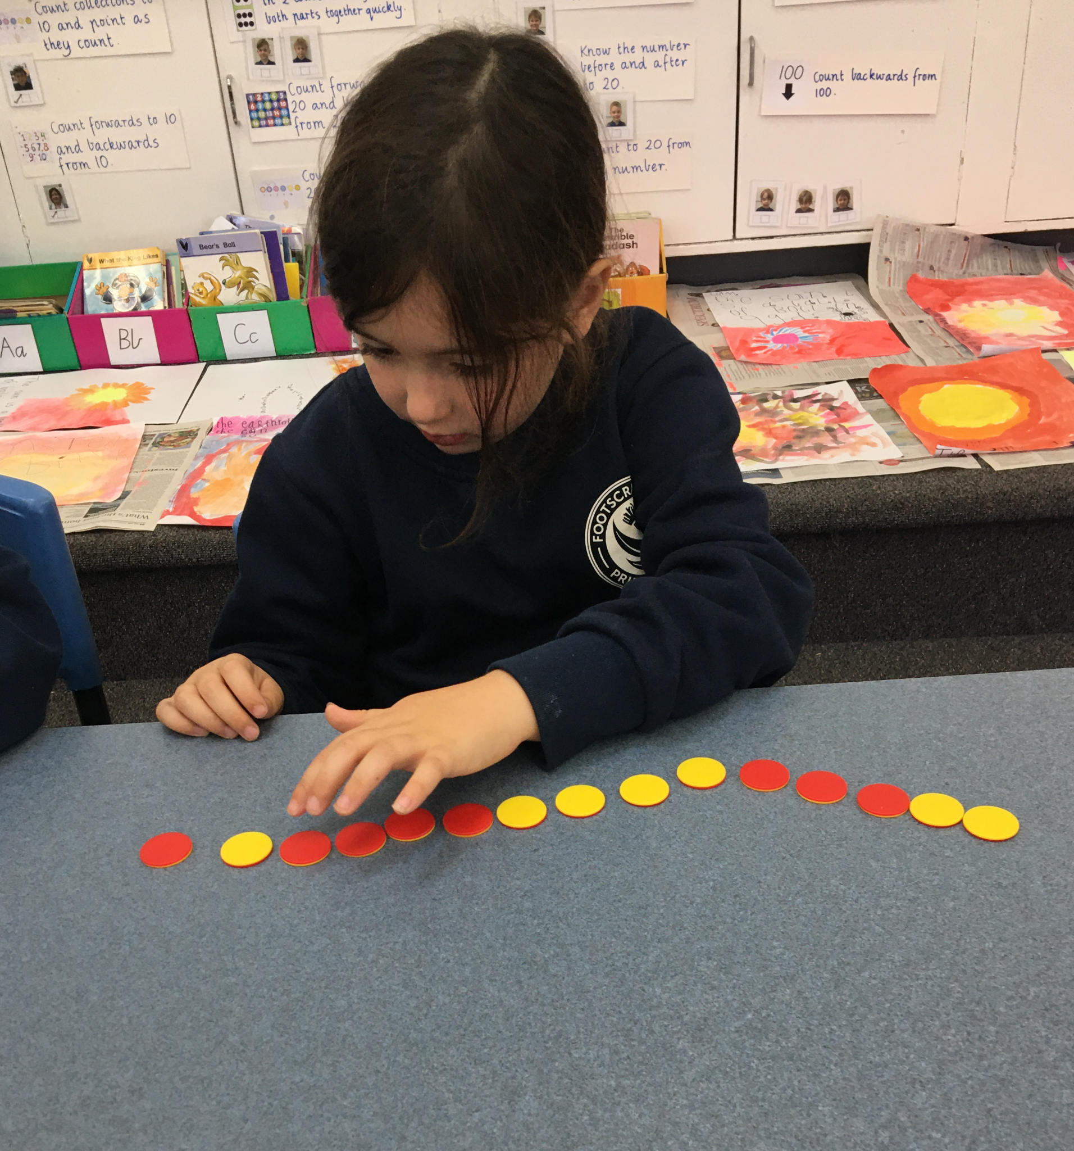
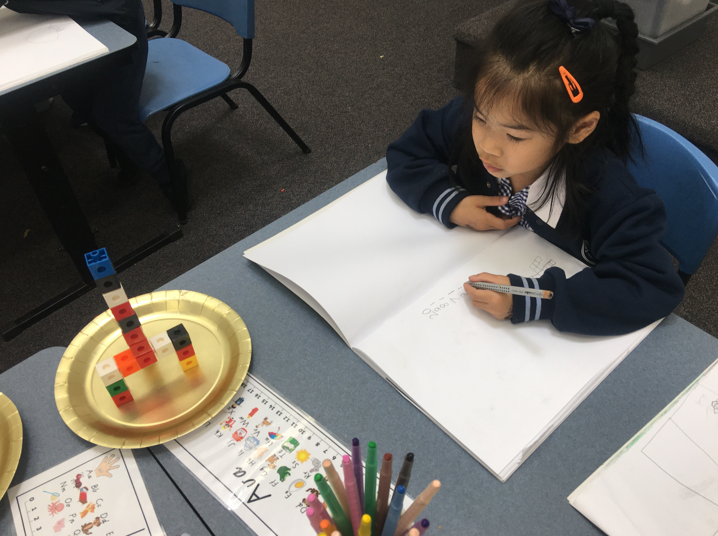
Mathematics
In Foundation, learning Mathematics builds on student’s prior knowledge, learning and experiences.
From here students engage in a range of approaches to learning that develop their:
Understanding of fluency with concepts
Real-life problem solving skills
Reasoning skills
Number sense
Use of processes to solve problems efficiently

Slide 14
Curriculum Overview - Concept
TERM ONE |  | TERM TWO | TERM THREE |  | TERM FOUR
Physical Science | Earth and Space | HISTORY | BIOLOGICAL SCIENCE | CHEMICAL SCIENCE | Geography | HEALTH
Enduring Understanding: Things move in different ways. | Enduring Understanding: There are different seasons each year. | Enduring Understanding: Learning our personal history allows us to reflect on who we are and where we’ve come from. | Enduring Understanding: Living things live in different places and have basic needs to survive. | Enduring Understanding: Everything in the world is made up of different materials, each with its own unique set of properties. | Enduring Understanding: TBC | Enduring Understanding: We all have a role to play in creating a safe, happy and supportive learning environment.

Slide 15
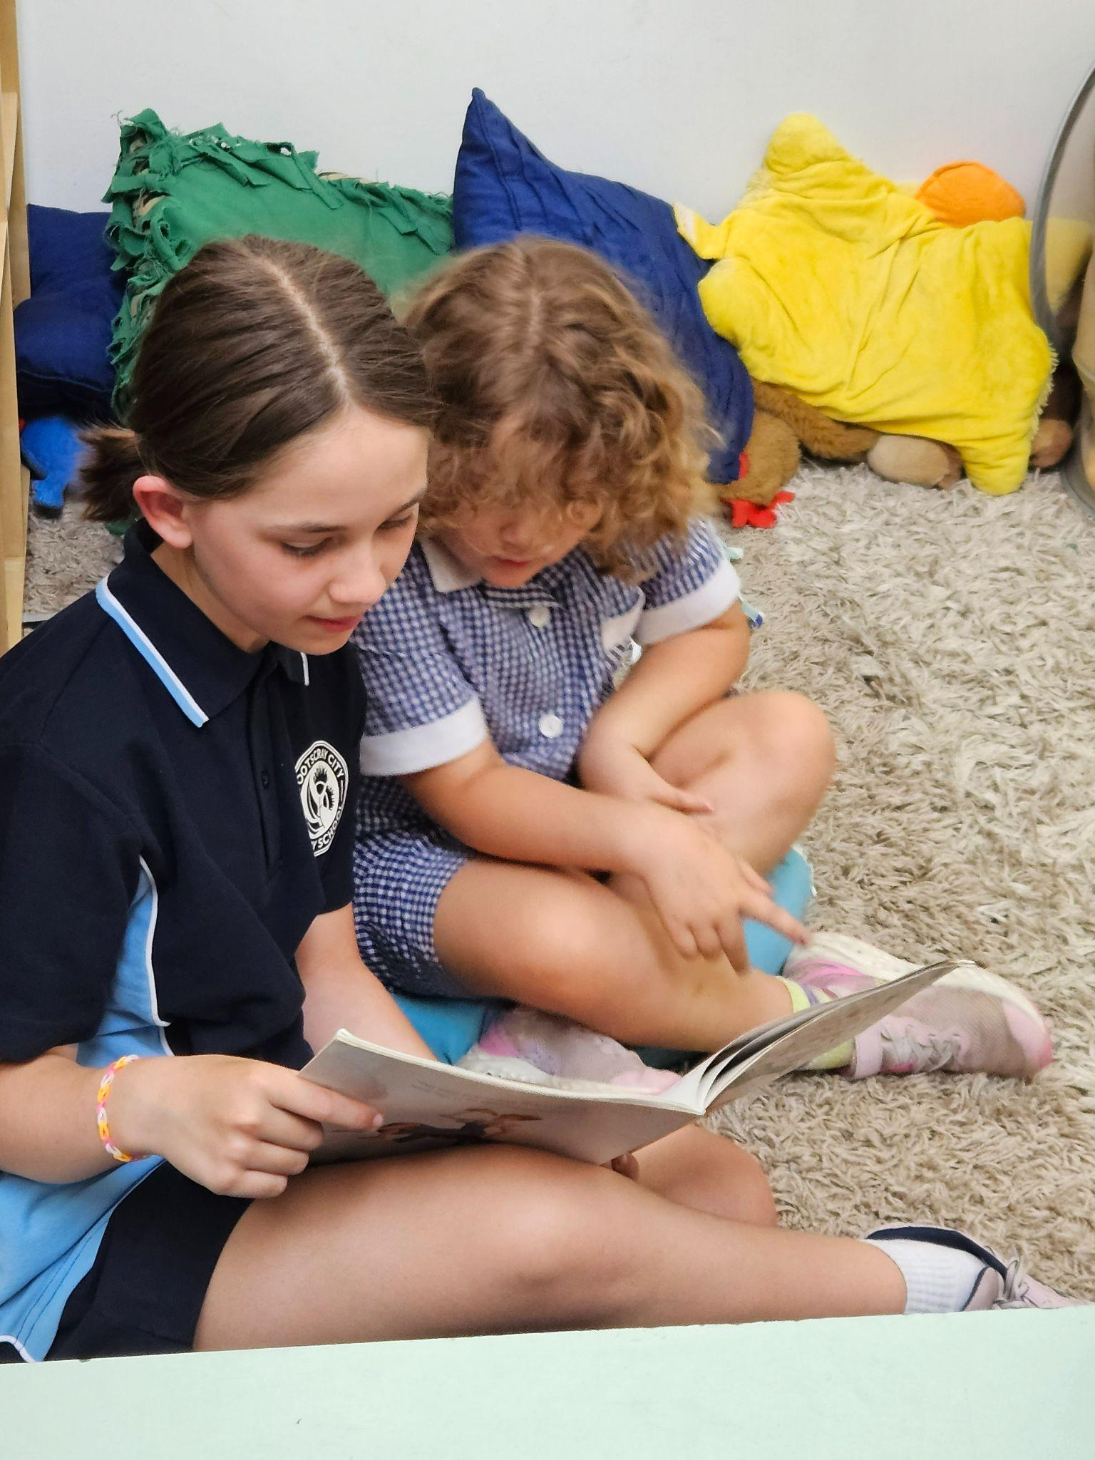
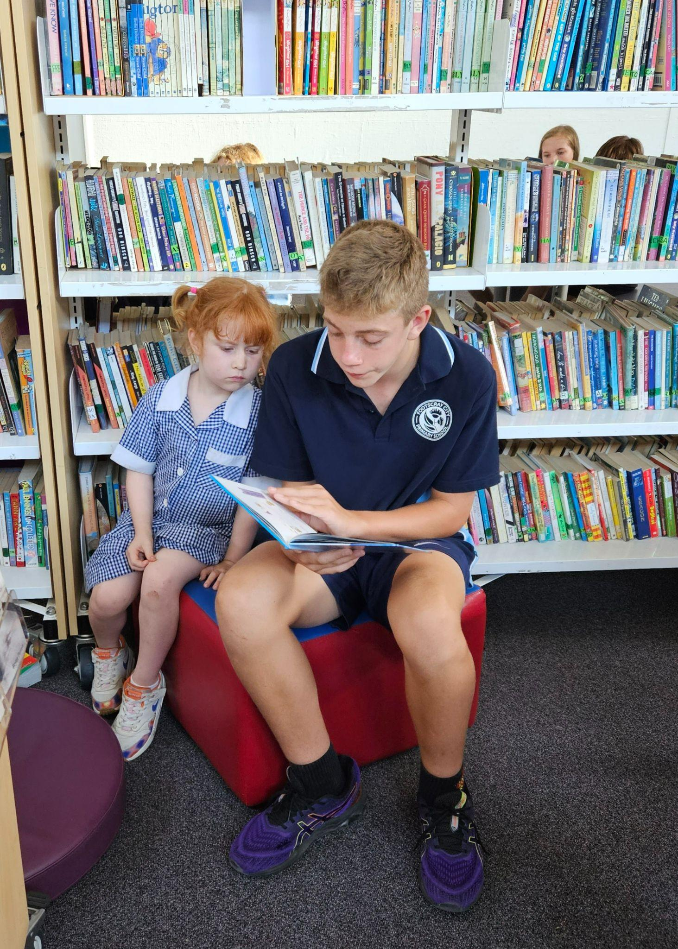
Buddies

Slide 16
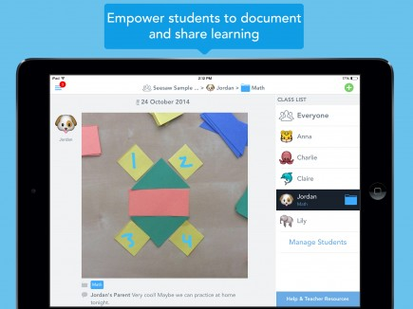
Making Learning Visible - Seesaw
Each child is setup with a digital portfolio on SeeSaw at the beginning of each school year.
It is a way to make learning visible
It shares students learning goals
It celebrates the progress towards and achievement of student learning goals
It provides opportunities for students to share and discuss their learning with their family

Slide 17
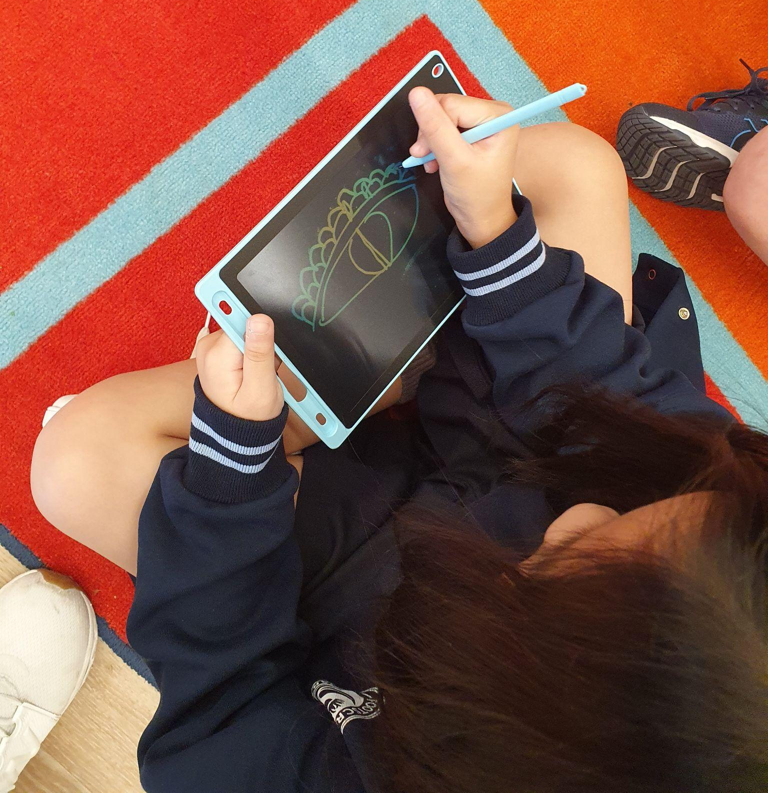
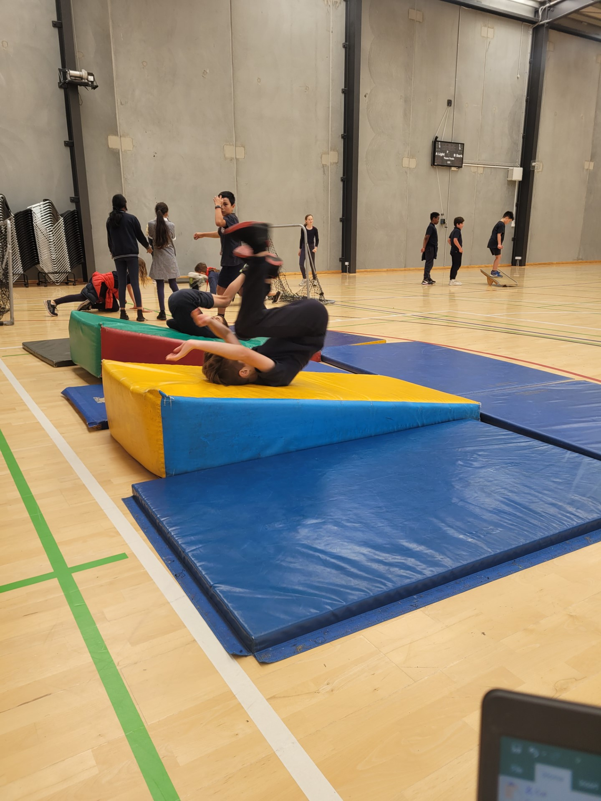
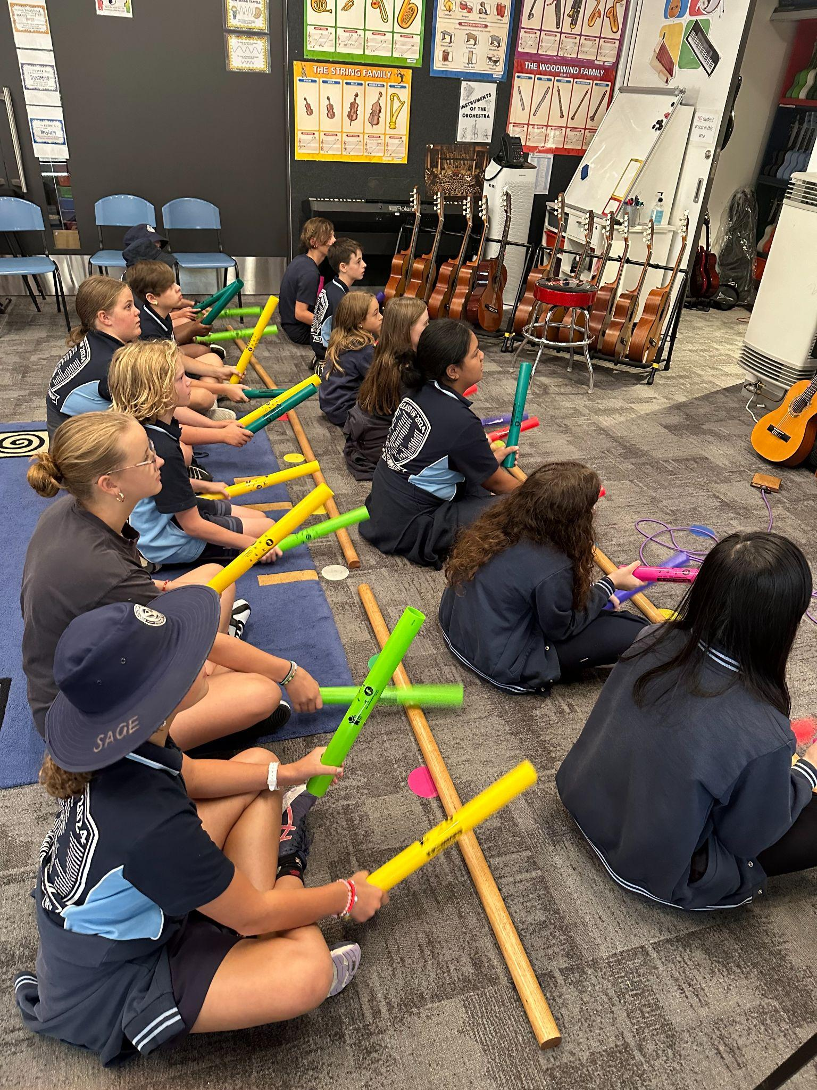
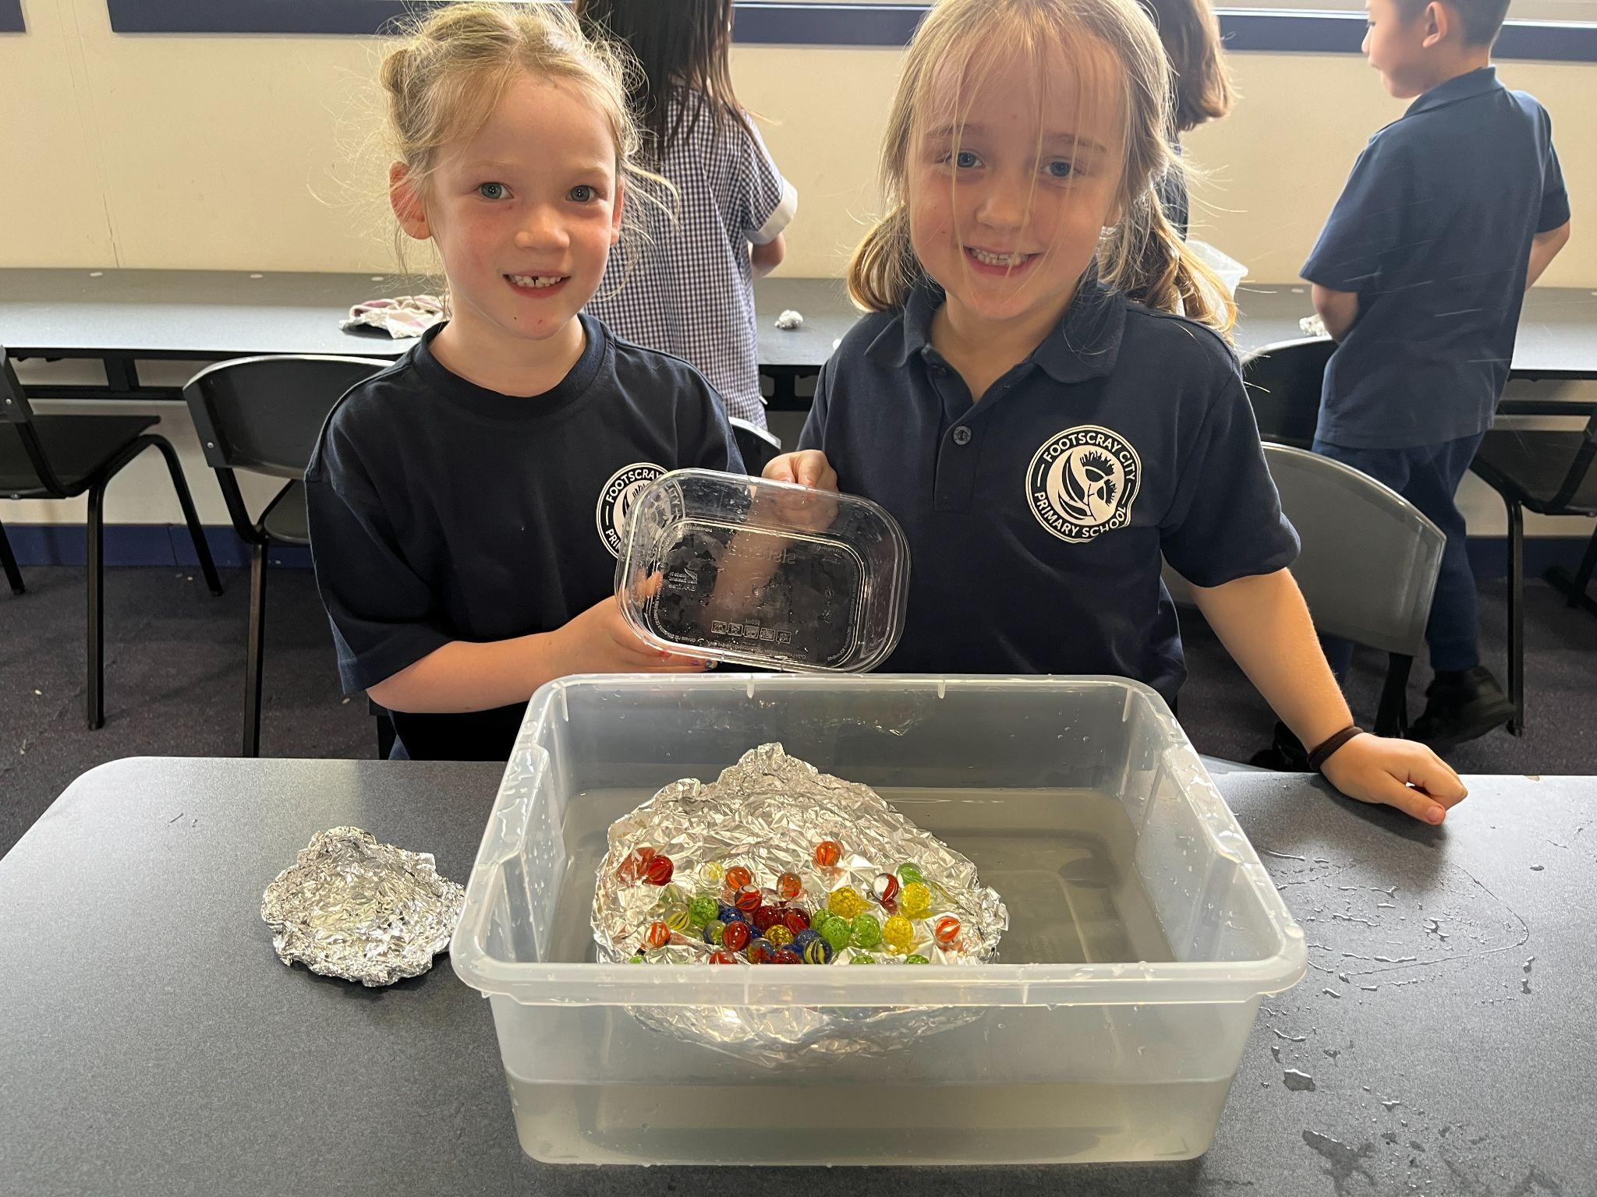
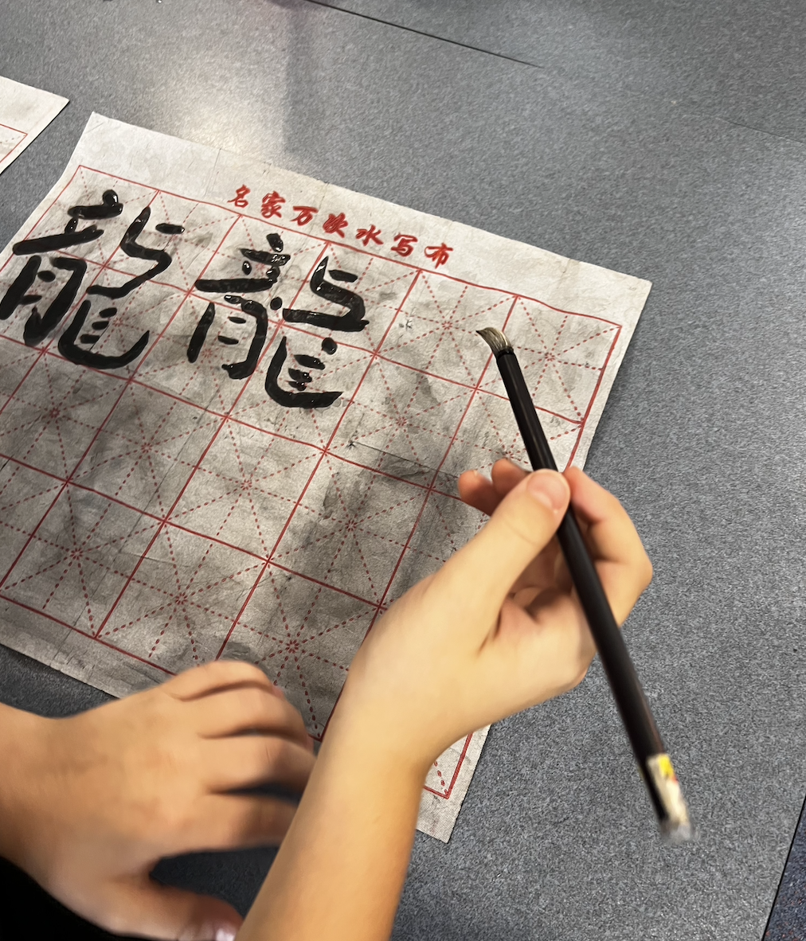
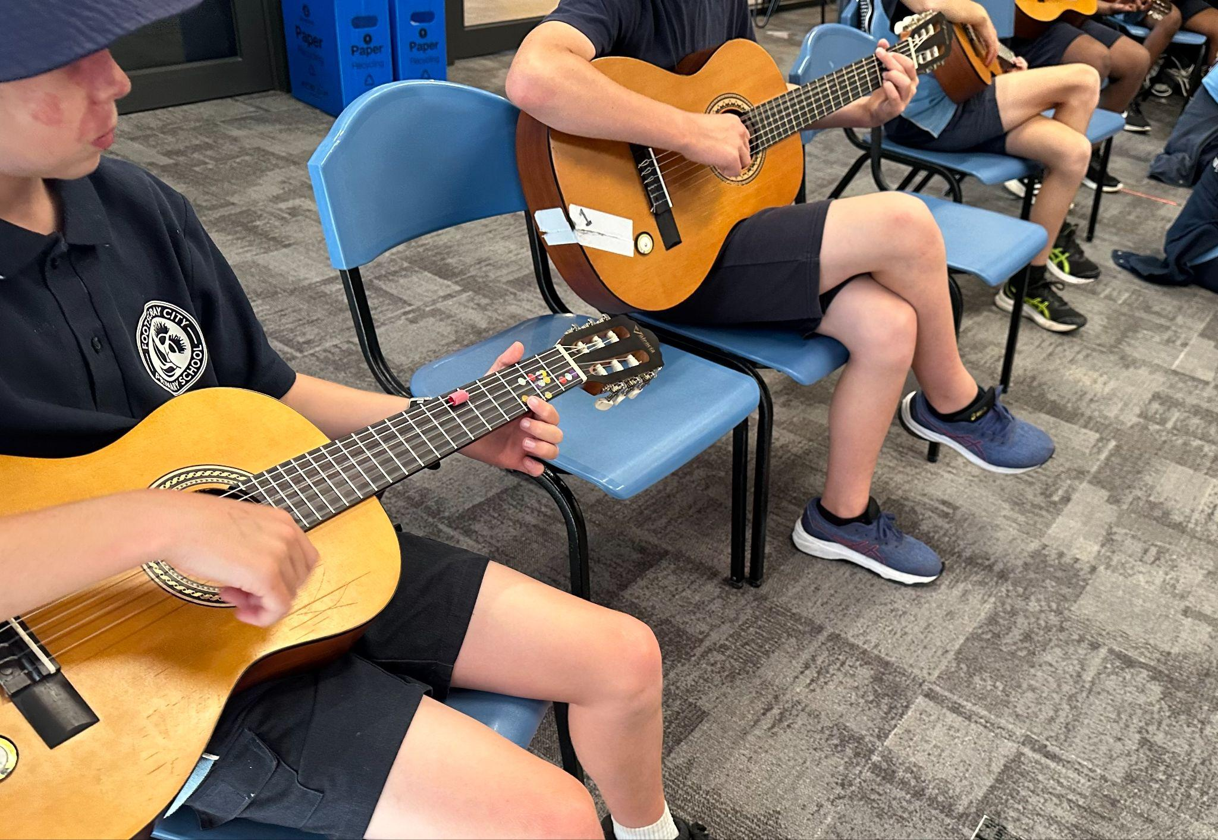
Specialist Program
LUNCHTIME CLUBS
Art
Physical Education
STEAM
Lote Chinese
Music
*Instrumental Music Program is also offered as an
additional with extra cost

Slide 18
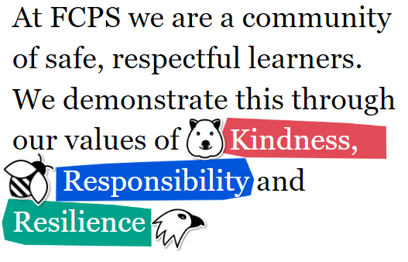
STUDENT ENGAGEMENT, HEALTH & WELLBEING
SWPBS
Topic 1: Emotional Literacy
Topic 3: Positive Coping
Topic 5: Stress Management

Slide 20
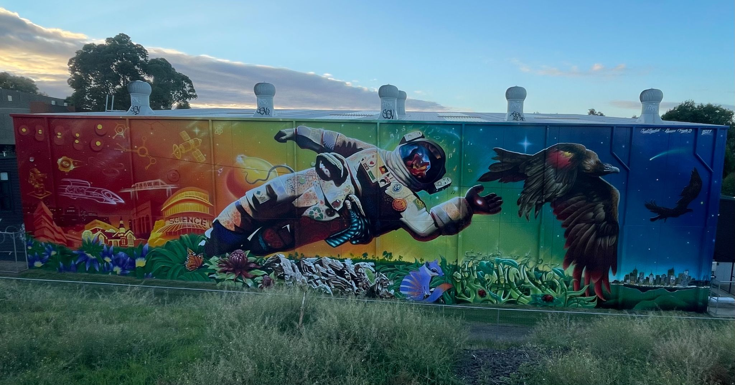
Footscray Learning Precinct
The vision of the Footscray Learning Precinct (FLP) is to be a world-class education precinct, providing excellence in learning and teaching in Melbourne’s inner west in all stages of education.

Slide 21
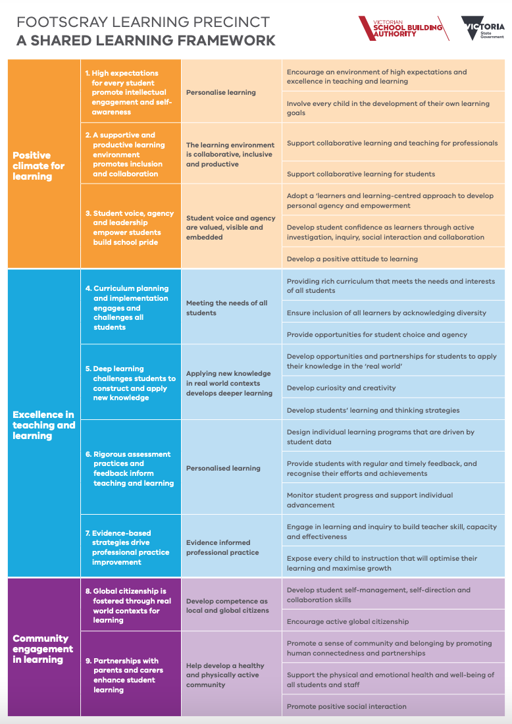
FLP Priorities

Slide 22
Pathways and transitions
What this means for FCPS families . . .
School-based experts
Collaboration with early childhood educators
Visits to early education settings
Building of learner profile to inform transition
Relationship with the school commences in kinder
Data informed decision making
Targeted interventions & support
Discussion around school readiness

Slide 23
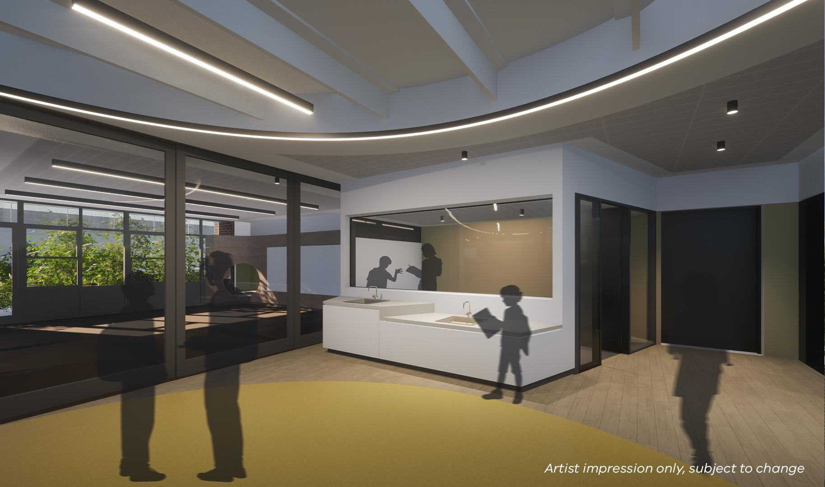
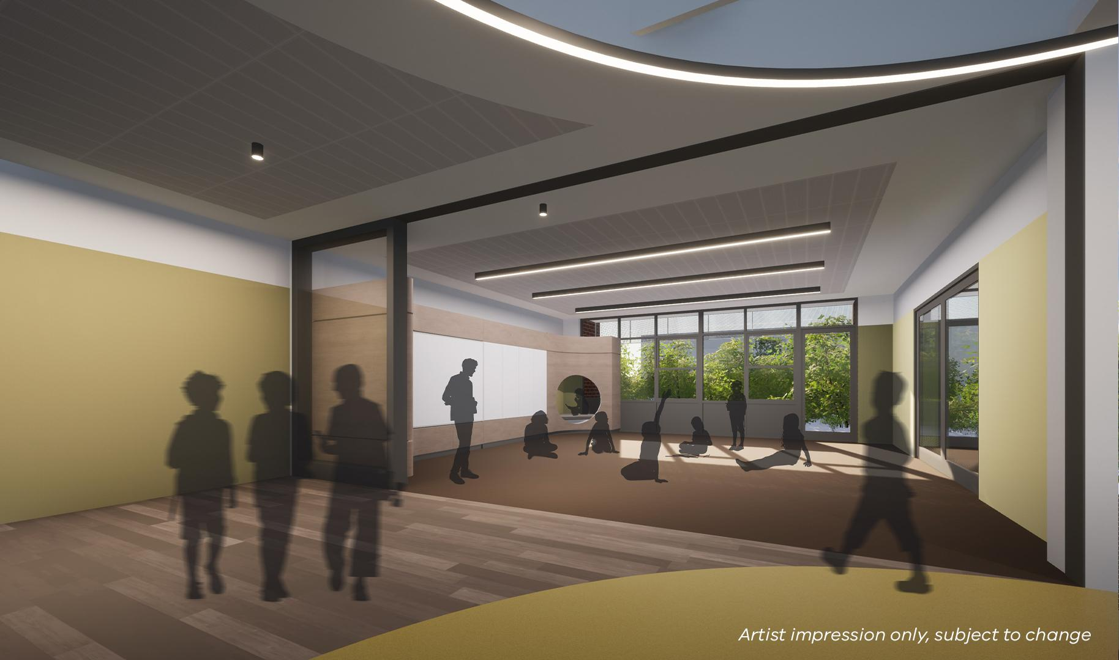
Capital Works Project
Learning Communities
Footscray Learning Precinct

Slide 24
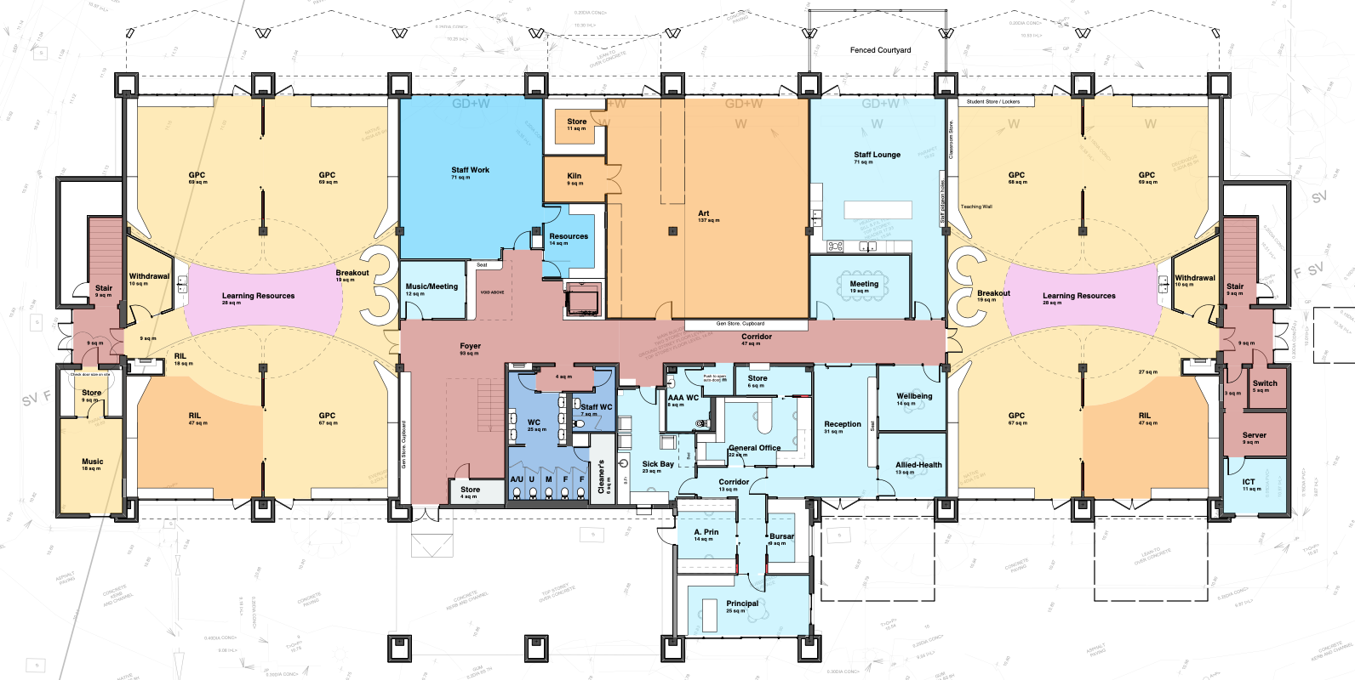
Capital Works Project
Three Stages - Ground Floor
Stage 3
Commencing Term 2 2024
Stage 1
Completed Term 3 2023
Stage 2
Completion due Term 1 2024

Slide 25
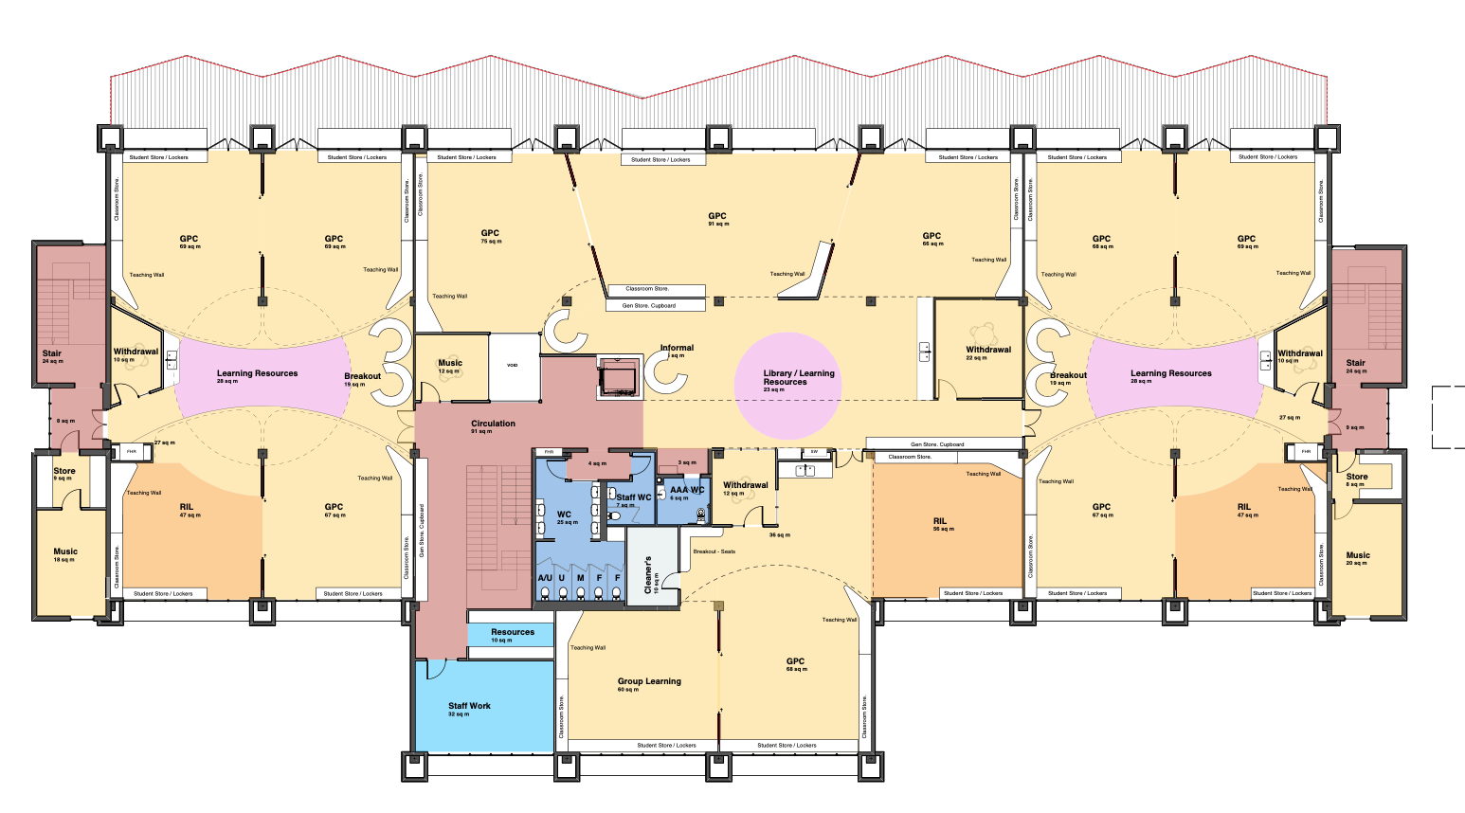
Capital Works Project
Three Stages - First Floor
Stage 3
Commencing Term 2 2024
Stage 1
Completed Term 3 2023
Stage 2
Completion due Term 1 2024

Slide 26
School Operations
CURRENT GRADE STRUCTURE 2024
Foundation | x3 *Additional 4th teacher part time | Average class size - 21.6
Year 1/2 | x5 | Average class size - 22.6
Year 3 | x3 | Average class size - 23
Year 4 | x3 | Average class size - 20.3
Year 5 | x4 | Average class size - 22.75
Year 6 | x3 | Average class size - 24.6
Overall Class Average Foundation - Year 6 Note - VGSA requirement that school average class size does not exceed 26 |  | Total enrolments = 470 Average class size = 22.3

Slide 27
WHAT HAPPENS NEXT - ENROLMENT
Children have the right to be placed in their designated neighbourhood school.
The designated neighbourhood school is the school that is nearest the student’s permanent residence.
We encourage all families to engage with their designated neighbourhood school.
Students are enrolled based on:
Students for whom the school is the designated neighbourhood school.
Students with a sibling at the same permanent address who are attending the school at the same time.
Students out-of-zone are enrolled based on:
Our capacity to accept out-of-zone students. The priority order of placement for out-of-zone enrolments are students in order of closeness of their home to the school.

Slide 28
WHAT HAPPENS NEXT - ENROLMENT
Term 1 | Foundation 2025 Enrolment Information Sessions (online) Thursday 21st March at 10am-11:30am Monday 25th March at 5:30pm-7:00pm
Term 2 | FCPS will send out an enrolment pack to each family with relevant forms and information at the beginning of Term 2. Families residing within the designated neighbourhood area and siblings will receive an enrolment form. Families resided outside of our school zone will receive an enrolment application form. New families to FCPS both in and out of zone will receive a link to book a school tour - running each Thursday from 2nd to 30th May from 9.30am - 10.30am. Schools can receive enrolment forms and applications from parents during Term 2.
Term 3 | Enrolment forms and enrolment applications are to be submitted by Friday, 26 July 2024 Schools notify parents and carers of the outcome of enrolment applications by Friday, 9 August 2024 Written non-placement appeals from parents and carers are to be lodged with schools by Friday, 23 August 2024 Schools notify parents and carers in writing of the outcome of non-placement appeals by Friday, 6 September 2024
Term 4 | Transition Program: Foundation 2025 Transition Session 1 - Thursday 31st October Foundation 2025 Transition Session 2 - Thursday 7th November Foundation 2025 Transition Session 3 - Thursday 14th November

Slide 29
Starting school in 2025
Term 1 - Week 1 2025 | Year 1 -6 Students start Wednesday 29th January 2025 Foundation students start Monday 3rd February 2025
Foundation Interviews | Wednesday 29th January- Friday 31st January
Term 1 - Week 2 | Foundation students attend 9am - 1pm Monday 3rd, Tuesday 4th, Thursday 6th and Friday 7th February Wednesday 5th - only attend if booked for an interview (otherwise students stay home for this Wednesday)
Term 1 - Week 3 | Monday 10th - Friday 14th February Foundation students attend all 5 days 9am - 3:30pm

Slide 30
Out of School Hours Care Program
Before and After School Care is offered onsite by Team Kids.
This operates between:
7:00am - 8:45am
3:30pm - 6:00pm
Foundation students are initially dropped off to their classroom in the morning when the school starts and they are picked up from their classroom in the afternoon at 3:30pm.
Team Kids also offer a Holiday Program.
Team Kids - Click here for further information

Slide 31
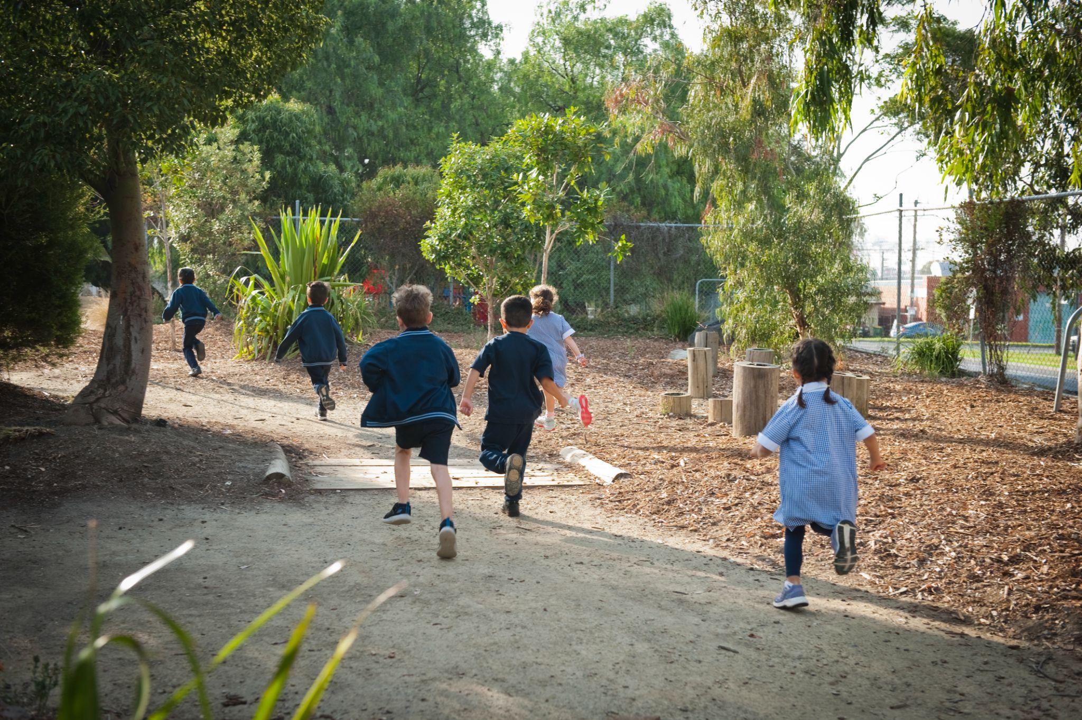
Thank-you
This session was designed to
Introduce you to key people and practices at Footscray City Primary School.
Communicate our key messages around how we approach student learning, engagement and wellbeing
Provide an overview of school operations
Provide clarity on the next steps in the enrolment process
By attending it is our intention that you will have
knowledge of the learning programs your child will participate in
understanding of how we approach learning and teaching
connections with what you want and need for your child to learn and thrive

